Slide 1

Coding GuildLine
Quy tắc
Phiên bản 1.0
Trần Thiện Khiêm
99 cents, Inc.
Notes:
Play the slide show for this presentation to listen to the audio commentary by Peter Walsh and view slide timings. Or, click the sound icon on a slide for controls that you can use to hear the audio at your own pace.
A little organization will go a long way to enhancing your PowerPoint presentation.
Your title slide should be catching and relevant to your audience – offer something in the title that your audience wants.
Keep some basic principles in mind:
Your slides should complement what you have to say, not say it for you.
Keep slides direct and to the point - less is more!
Choose a background color or design that enhances and complements your presentation rather than competes with it.
Don’t get too fancy - a simple font, elegant color scheme and clear message is more important than lots of information (clutter!) on the slide.
Keep it simple! The purpose of the PowerPoint slide is to keep the mind of your audience focused – fewer words are better.
Note: You understand that Microsoft does not endorse or control the content provided in the following presentation.

Slide 2

Quy tắc đặt tên biến.
Đồng bộ cách đặt tên…
1
Sử dụng danh từ tiếng Anh để đặt tên biến. Biến boolean thì đặt bắt đầu bằng `is` hoặc `has`
2
Sử dụng camelBackCase.
3
Tên biến phải có ý nghĩa rõ ràng.
4
Không sử dụng prefix cho tên biến (vd: m_iPointerX). Vì sao? Tên biến có ý nghĩa thì chúng ta hoàn toàn biết được nó kiểu gì.
Notes:
Keep your presentation logical and be sure that one point flows to the next. If there are sub-points, add them with an additional slide.
Make sure that when you move to a new main bullet point your audience knows where they are in the presentation.
If you sense that you’re losing your audience – summarize what you’ve said and pick up the pace.

Slide 3
Quy tắc đặt tên biến.
Đồng bộ cách đặt tên…
5
Không viết tắt các tên biến quan trọng. Trừ phi từ viết tắt đó phổ biến.
6
Biến đếm sử dụng là i, j, k.
7
Không sử dụng chữ ‘l’ để đặt tên biến
8
Giải thích ý nghĩa của biến đó = comment khi khai báo nếu cần thiết.
Notes:
Keep your presentation logical and be sure that one point flows to the next. If there are sub-points, add them with an additional slide.
Make sure that when you move to a new main bullet point your audience knows where they are in the presentation.
If you sense that you’re losing your audience – summarize what you’ve said and pick up the pace.

Slide 4
Quy tắc đặt tên Lớp.
Đồng bộ cách đặt tên…
1
Sử dụng danh từ tiếng Anh để đặt tên lớp.
2
Sử dụng CamelCase.
3
Tên lớp phải trùng với tên File chứa nó.
4
+ Các quy tắt đặt tên biến.
Notes:
Keep your presentation logical and be sure that one point flows to the next. If there are sub-points, add them with an additional slide.
Make sure that when you move to a new main bullet point your audience knows where they are in the presentation.
If you sense that you’re losing your audience – summarize what you’ve said and pick up the pace.

Slide 5
Quy tắc đặt tên Hàm.
Đồng bộ cách đặt tên…
1
Sử dụng Động Từ để đặt tên biến.
2
Sử dụng CamelCase. (Không sử dung backCamelCase như Java).
3
+ Các quy tắt đặt tên biến.
Notes:
Keep your presentation logical and be sure that one point flows to the next. If there are sub-points, add them with an additional slide.
Make sure that when you move to a new main bullet point your audience knows where they are in the presentation.
If you sense that you’re losing your audience – summarize what you’ve said and pick up the pace.

Slide 6
Line Break
1
Chỉ được viết mỗi câu lệnh trên 1 dòng.
2
Không viết dòng quá dài(> 80 kí tự).
3
Xuống dòng hợp lí.
Notes:
Keep your presentation logical and be sure that one point flows to the next. If there are sub-points, add them with an additional slide.
Make sure that when you move to a new main bullet point your audience knows where they are in the presentation.
If you sense that you’re losing your audience – summarize what you’ve said and pick up the pace.

Slide 7
Space & Căn lề.
1
Sử dụng Space.
2
Sử dụng 2 space để căn lề, không dùng tab.
3
Các ví dụ về sử dụng space & căn lề.
Notes:
Keep your presentation logical and be sure that one point flows to the next. If there are sub-points, add them with an additional slide.
Make sure that when you move to a new main bullet point your audience knows where they are in the presentation.
If you sense that you’re losing your audience – summarize what you’ve said and pick up the pace.

Slide 8
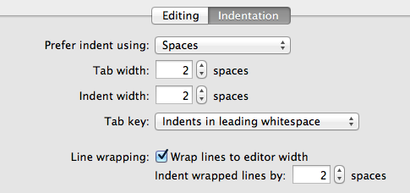
Indent Settings
Notes:
Watch your timing! Allocate a time for each slide and stick to it so as to keep track of your presentation and avoid speaking too much.

Slide 9
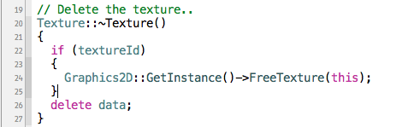
Indent Settings
Đặt dấu ngoặc theo phong cách C.
if, while, do, switch có khoảng trắng sau đó mới đến (.
Lệnh gọi hàm không có khoảng trắng.
// Comment về chức năng của hàm.
Lệnh if bắt buộc phải mở 1 block dù chỉ có 1 lệnh.
Notes:
Watch your timing! Allocate a time for each slide and stick to it so as to keep track of your presentation and avoid speaking too much.

